Slide 1
Hans Rosling (Visualization Example)

Slide 2
200 Countries, 200 years, 4 minutes
View Hans Rosling's famous 200 Countries, 200 Years, 4 Minutes - The Joy of Stats - BBC Four, available at: http://www.youtube.com/watch?v=jbkSRLYSojo.
Visualization – provides a graphic representation of the world’s populations growth by countries and time.

Slide 3


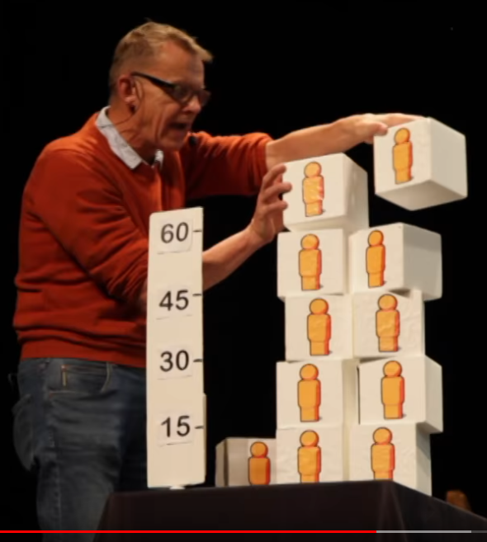

Why the world population won’t exceed 11 billion | Hans Rosling |
https://www.youtube.com/watch?v=2LyzBoHo5EI
Optional – interesting. See cubes for explanation (3:49)
Question: What are the implications for information technology?

Slide 4
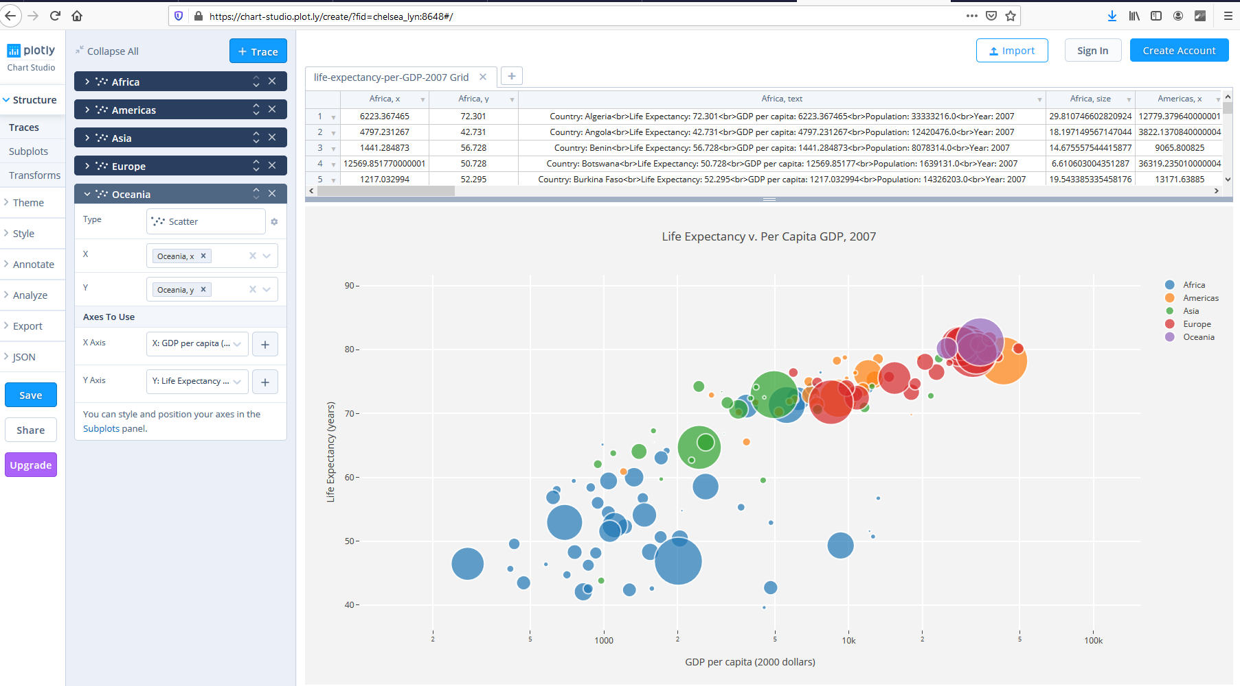
https://chart-studio.plot.ly/create/?fid=chelsea_lyn:8648#/

Slide 5
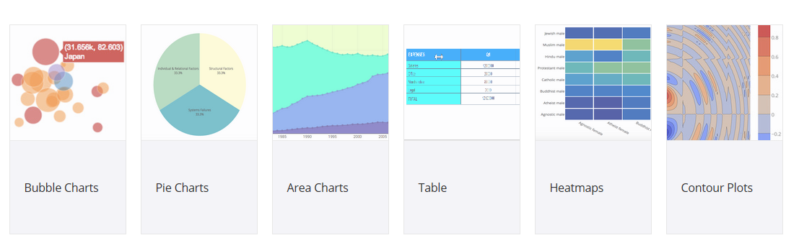
How are you going to represent your data analytics results to your boss?
Recall: Know your decision maker discussion.
https://help.plot.ly/tutorials/#transforms

